Slide 1
Surface Energy Balance and Evapotranspiration remote sensing
Lecture 8

Slide 2
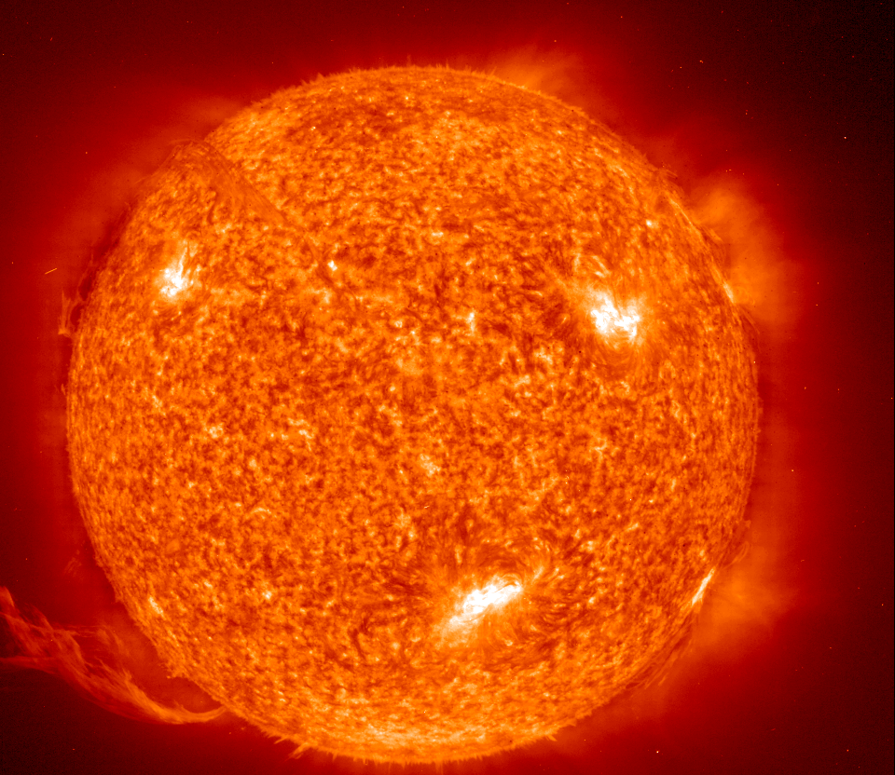
radiation
Longwave
Shortwave
(1- α)S_{in}
Latent Heat
( )
Longwave
(L_{out})
Sensible Heat
(H)
(1 - ε₀)L_{in}
Longwave
1. Energy Balance
(L_{in})
Energy Balance
Net radiation ( )
Ground Heat
(G)
(Radiance Balance)
. Net radiation absorbed by the land
. Albedo
Units : W/m²
. Emissivity
(Heat Balance)
. Latent Heat Flux
G . Heat transfer to the ground (soil)
H . Sensible heat flux loss to the air due to convection and
conduction
R_{n}-G called available energy (or Q_{a})
Notes:
computer the land surface energy balance “at the Satellite overpass time”
albedo, is the percent of incoming solar radiation reflected by a surface
emissivity, <> the radiance from a mineral at one temperature will be different from that at another temperature. In order to make comparisons of emission from materials at different temperatures, we need to remove the temperature effect. This is done mathematically by dividing the radiance spectrum of a selective emitter by that of a blackbody (perfect emitter) at the same temperature. The result is called an emissivity spectrum. Because it results from dividing one radiance spectrum by another, the units of watts/area cancel. Emissivity then, is a fractional representation of the amount of energy from some material vs. the energy that would come from a blackbody at the same temperature. The places in an emissivity spectrum that have a value less than one are the wavelength regions that molecules are absorbing energy. In the case of quartz (SiO2), the silicon-oxygen molecules are responsible for the absorptions
if surface reflectance of incoming long wave radiation is taken into account.
emmisivity is the percent of incoming long wave radiation has been absorbed, 1-emmisivity is percent of radiation will be raflected back to the atmosphere.
heat convection to the atmosphere

Slide 3
Evapotranspiration
Evaporation: Liquid water is converted to water vapor and removed from evaporating surface (lake, river, pavement, soils, and wet vegetation)
Transpiration: Vaporization of liquid water contained in plant tissue and the vapor removal to the atmosphere through the stomata
Evaporation and transpiration occur simultaneously and there is no easy way of distinguishing between the two processes. They are often measurement together.
Potential ET (PET): The evapotranspiration of a surface with optimal water condition (both on the surface and in the root zone) for E and T. It depends on micrometeorological condition, as well as the surface characteristics. It is the largest water availability (or loss) from a vegetated land surface under given climate and weather condition but not limited by soil moisture.
Reference ET is the PET of the reference (clipped) grass (h= 0.12m) or the (full-covered) alfafa (h>0.3 m).

Slide 4
Quantifying Evapotranspiration
Coupling of energy balance and water balance equations
Water balance method
Energy balance method
(e.g., bowen ratio - energy balance)
Eddy covariance method
Scintillometry method
Aerodynamic method
Combination approach (energy balance + aerodynamic)
Penman-Monteith equation

Slide 5
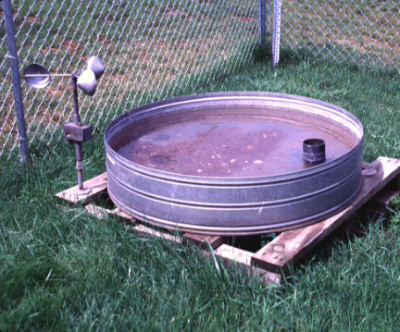
Water balance: Evaporation pan
Evaporation Pan -- In hydrologic terms, a pan used to hold water during observations for the determination of the quantity of evaporation at a given location. Such pans are of varying sizes and shapes, the most commonly used being circular or square. 121cm diameter x 24cm deep
Write water balance equation for the pan.
What variables do we measure to determine E
What do you think of the pan
evaporation measurement?
Can it be a good estimate for lake E?
Can you think of a better way to install evaporation pan?

Slide 6
Water balance: Lysimeter
Left and center, construction of the two large weighing lysimeters at KREC began in 1986. Each lysimeter consists of an underground chamber that houses a balancebeam
weighing system with a rectangular “flower pot” measuring 6.5 feet wide by 13 feet long by 6.5 feet deep. Right, researchers
enter the completed lysimeter.

Slide 7
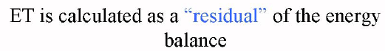
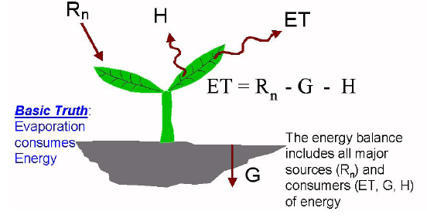
Remote sensing ET using energy balance method

Slide 8
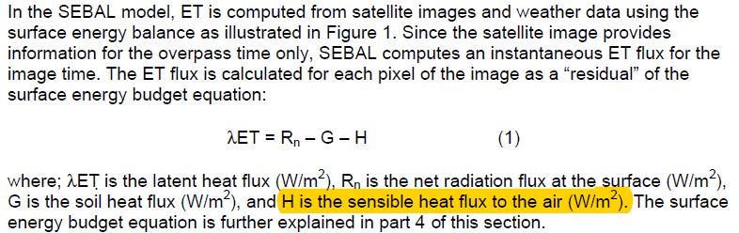
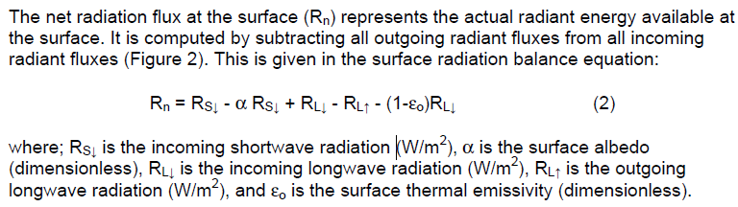

Slide 9
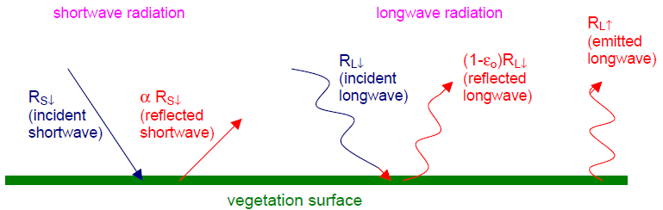
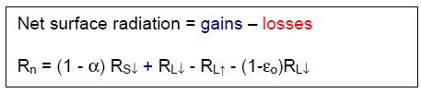

Slide 10
SEBAL-METRIC model
Developed by
Wim Bastiaanssen, The Netherlands
Richard Allen, University of Idaho
SEBAL needs both short wave and thermal bands
SEBAL can use images from:
NASA-Landsat (30 m, Since 1982)
NOAA-AVHRR (advanced very high resolution radiometer) (1 km, daily) - since 1980’s
NASA-MODIS (moderate resolution imaging spectroradiometer) (500 m, daily) - since 1999
NASA-ASTER (Advanced Spaceborne Thermal Emission and Reflection Radiometer) (15 m, 8 days) - since 1999

Slide 11
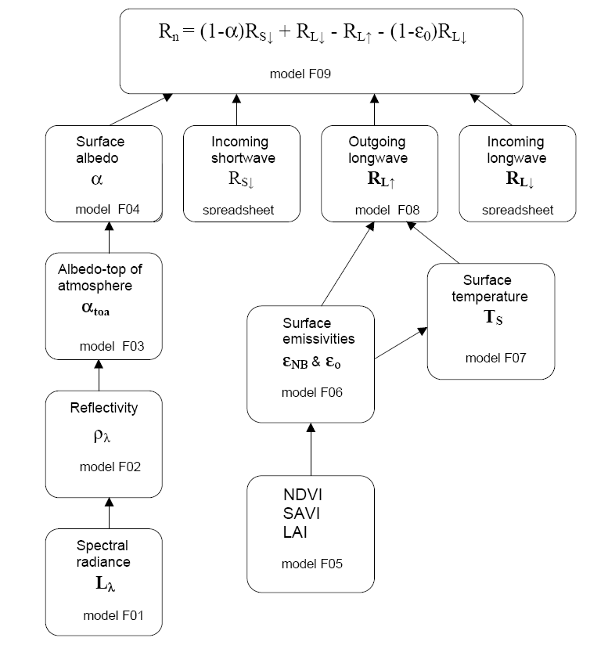
Estimating
Net radiation

Slide 12
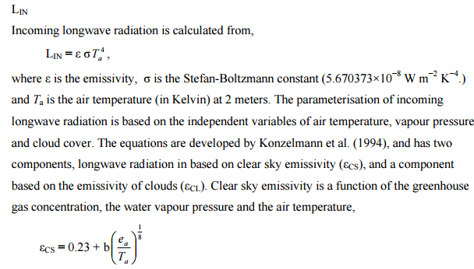
Estimating
Net radiation: Longwave Radiation

Slide 13
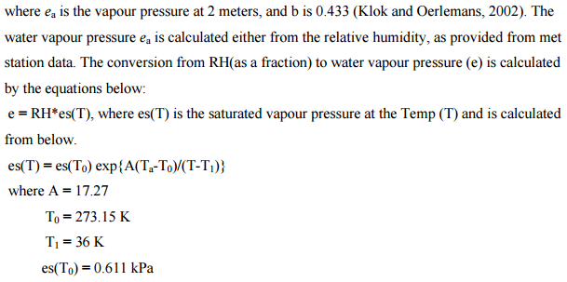
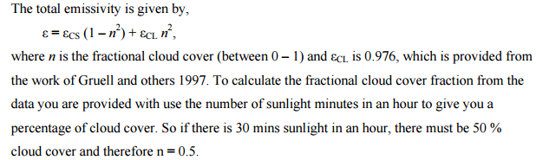
Estimating
Net radiation: Longwave Radiation

Slide 14
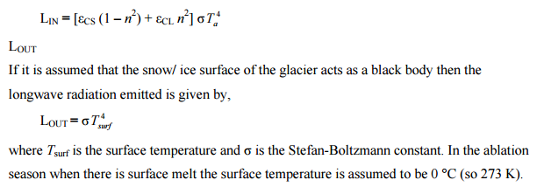
Estimating
Net radiation: Longwave Radiation

Slide 15
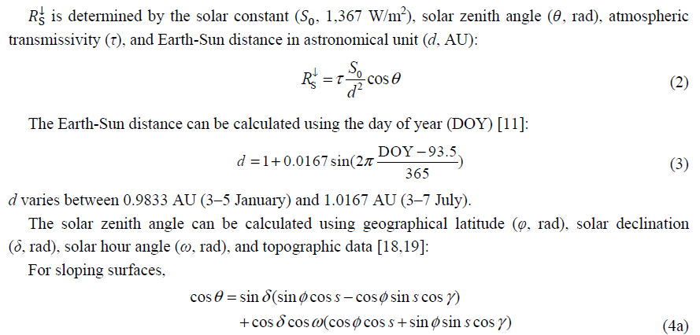
Estimating
Net radiation: Shortwave Radiation

Slide 16
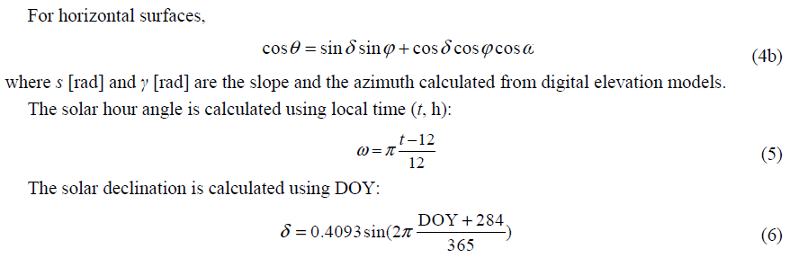
Estimating
Net radiation: Shortwave Radiation

Slide 17
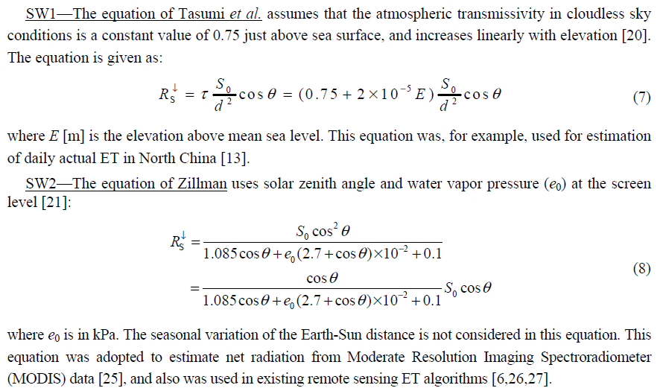
Estimating
Net radiation: Shortwave Radiation

Slide 18
Estimating
Short-wave Albedo

Slide 19
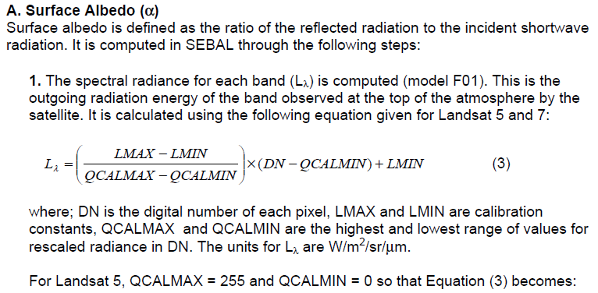
Estimating
Short-wave Albedo

Slide 20
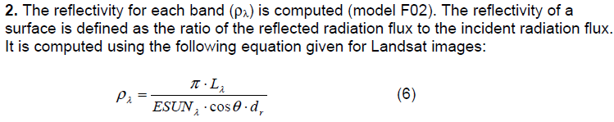
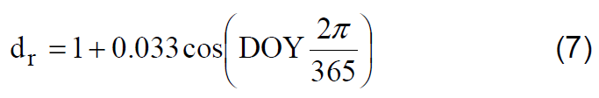
Estimating
Short-wave Albedo

Slide 21
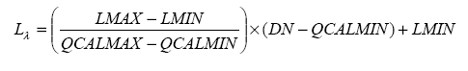
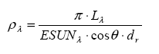
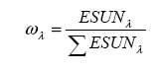
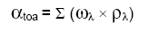
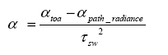
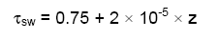
Estimating
Short-wave Albedo
Values for α of path_radiance range between 0.025 and 0.04 and for SEBAL. It is
recommended a value of 0.03 based on Bastiaanssen (2000).

Slide 22
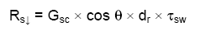
Estimating
Incoming short-wave
radiation
G_{sc} is the solar constant (1367 W/m2),
cos θ is the cosine of the solar incidence angle,
dr is the inverse squared relative earth-sun distance
τ_{sw} is the atmospheric transmissivity.
z is the elevation above sea level (m).

Slide 23
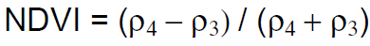
Estimating surface emitted
long-wave radiation:
- The outgoing longwave radiation is the thermal radiation flux emitted from the
earth’s surface to the atmosphere (W/m²).
Three commonly used vegetation indices are computed.
Normalized Difference Vegetation Index (NDVI),
Soil Adjusted Vegetation Index (SAVI)
Leaf Area Index (LAI) are computed using the reflectivity values.
The NDVI is the ratio of the differences in reflectivity for the near-infrared band (ρ₄) and the red band (ρ₃) to their sum:
where; ρ₄ and ρ₃ are reflectivities for bands 4 and 3 and are found in the output file of model.
The SAVI is an index that attempts to “subtract” the effects of background soil from NDVI so that impacts of soil wetness are reduced in the index. It is computed as:

Slide 24
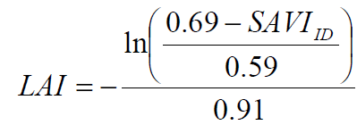
Estimating surface emitted
long-wave radiation:
where; L is a constant for SAVI. If L is zero, SAVI becomes equal to NDVI. A value of 0.5 frequently appears in the literature for L. However, a value of 0.1 is used to better represent soils.
The value for L can be derived from analysis of multiple images where vegetation does not change, but surface soil moisture does.
The LAI is the ratio of the total area of all leaves on a plant to the ground area represented by the plant. It is an indicator of biomass and canopy resistance. LAI is computed using the following empirical equation:
- The maximum value for LAI is 6.0, which corresponds to a maximum SAVI of 0.687.
Beyond SAVI = 0.687, the value for SAVI “saturates” with increasing LAI and does not change significantly.
Users must realize that the relationship between SAVI and LAI can vary with location and crop type.
Ihe relationship between SAVI and LAI can vary with location and crop type.

Slide 25
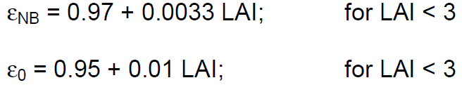
Estimating surface emitted
long-wave radiation:
2. Surface emissivity (ε) is the ratio of the thermal energy radiated by the surface to the thermal energy radiated by a blackbody at the same temperature. Two surface emissivities are used in SEBAL. The first is an emissivity representing surface behavior for thermal emission in the relatively narrow band (NB) 6 of Landsat (10.4 to 12.5 μm), expressed as ε_{ΝΒ}. The second is an emissivity representing surface behavior for thermal emission in the broad thermal spectrum (6 to 14 μm), expressed as ε_{ο}. ε_{ΝΒ} is used in calculation of surface temperature (Ts) and ε_{ο} is used later on to calculate total long wave radiation emission from the surface.
The surface emissivities are computed using the following empirical equations, where NDVI > 0:
and ε_{ΝΒ} = 0.98 and ε₀ = 0.98 when LAI ≥ 3.
For water and snow we use “filters” in the model to set the value of ε_{ΝΒ} and ε_{o}:
surface albedo (α)

Slide 26
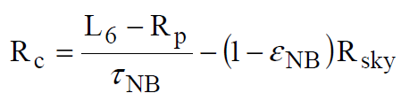
Estimating surface emitted
long-wave radiation:
3. The corrected thermal radiance from the surface (Rc) is calculated following Wukelic et al. (1989) as:
where; L₆ is the spectral radiance of band 6 (W/m2/sr/μm), Rp is the path radiance in the 10.4 – 12.5 μm band (W/m²/sr/μm), R_{sky} is the narrow band downward thermal radiation for a clear sky (W/m²/sr/μm), and τ_{NB} is the narrow band transmissivity of air (10.4 – 12.5 μm). Units for R_{c} are W/m²/sr/μm.
The corrected thermal radiance (Rc) is the actual radiance emitted from the surface whereas L6 is the radiance that the satellite “sees”.
In between the surface and the satellite two things occur. First, some of the emitted radiation is intercepted by the atmosphere (transmissivity). Second, some thermal radiation is emitted by the atmosphere in the direction of the satellite (path radiance) and the satellite “thinks” that this is from the surface is confused as being emitted from the surface.
Values for R_{p} and τ_{NB} require the use of an atmospheric radiation transfer simulation.
In the absence of values for these terms, they can be ignored by setting R_{p} = 0 and τ_{NB} = 1 and the R_{sky} term can also be ignored by setting R_{sky} = 0.

Slide 27
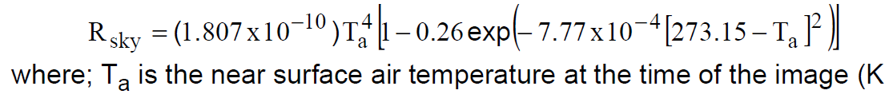
Estimating surface emitted
long-wave radiation:

Slide 28
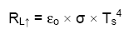
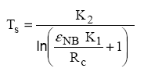
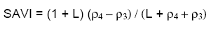
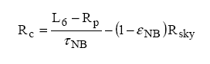
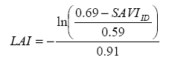
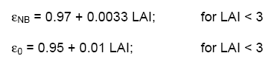
Estimating surface emitted
long-wave radiation:

Slide 29
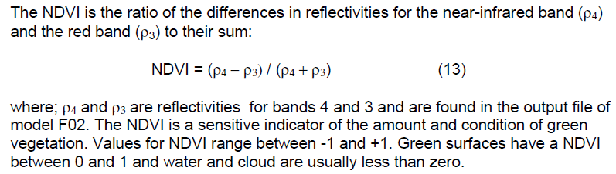
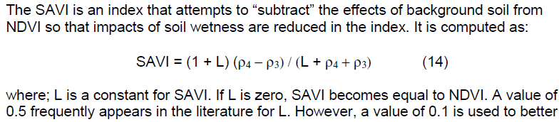
Estimating surface emitted
long-wave radiation

Slide 30
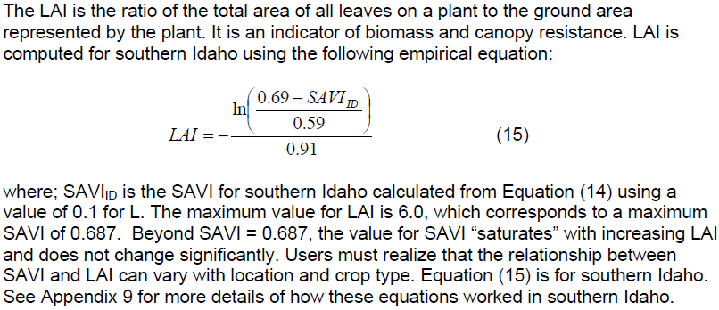
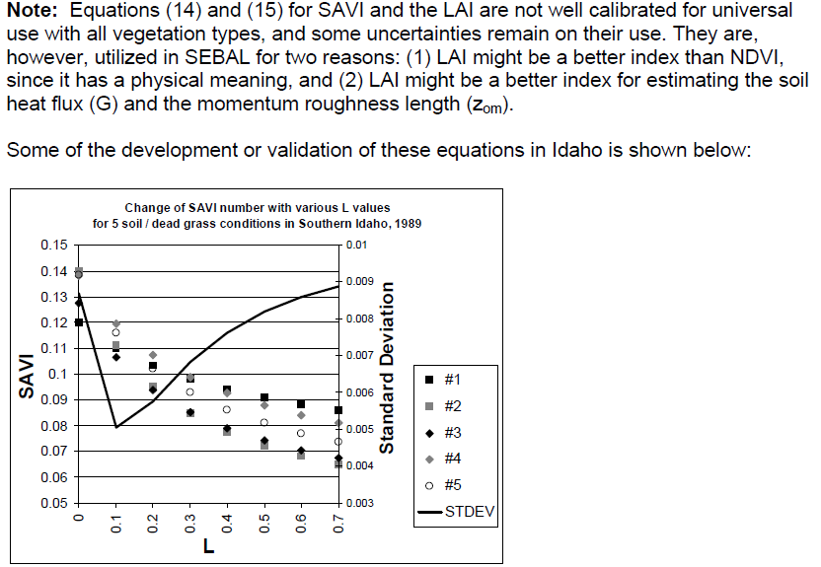
Estimating surface emitted
long-wave radiation

Slide 31
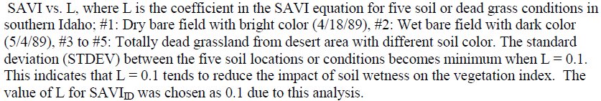
Estimating surface emitted
long-wave radiation

Slide 32
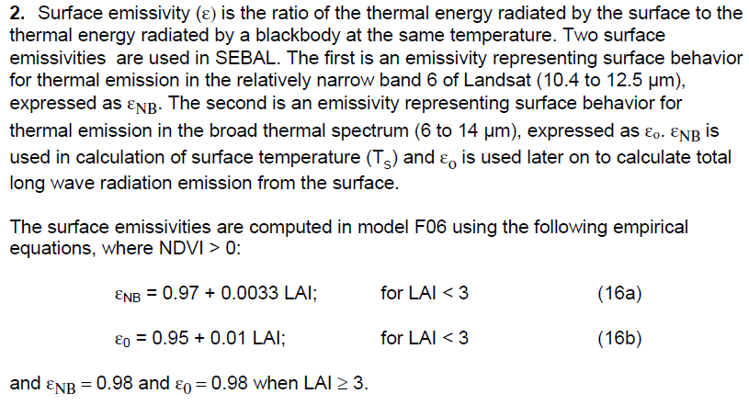
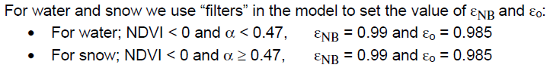
Estimating surface emitted
long-wave radiation

Slide 33
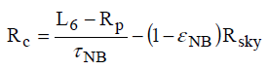
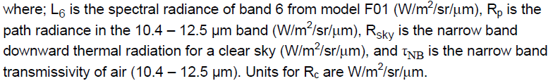
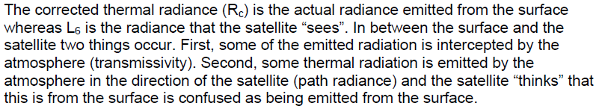
Estimating surface emitted
long-wave radiation

Slide 34
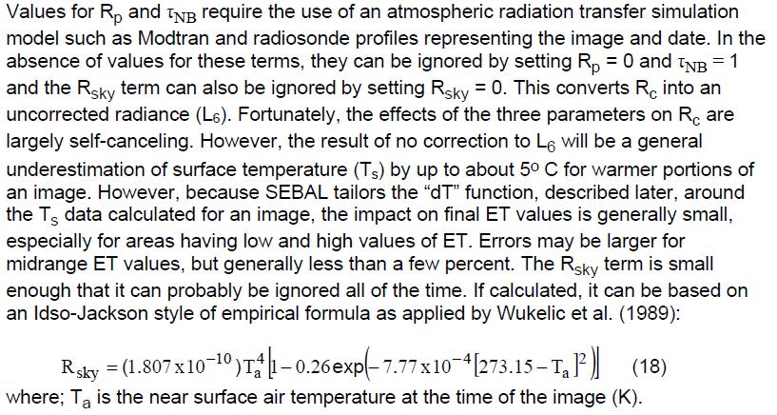
Estimating surface emitted
long-wave radiation

Slide 35
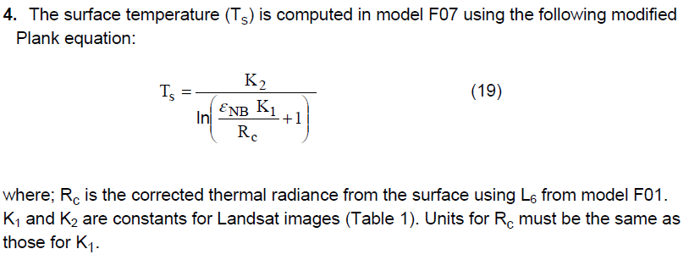
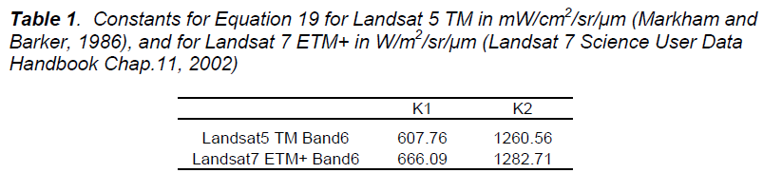
Estimating surface emitted
long-wave radiation

Slide 36

Estimating Outgoing
long-wave radiation

Slide 37

Selection of “Anchor Pixels”
The SEBAL process utilizes two “anchor” pixels to fix boundary conditions for the energy balance.
“Cold” pixel: a wet, well-irrigated crop surface with full cover T_{s} ≅ T_{air}
“Hot” pixel: a dry, bare agricultural field ET ≅ 0

Slide 38



Estimating Incoming long-wave radiation

Slide 39

Estimating
Net radiation

Slide 40
Net Radiation for 24 hours

Slide 41
24hour Potential ET

Slide 42


Estimating ground heat flux or

Slide 43








Estimating
sensible heat (H)
Where:
k is von Karman’s constant,
ux is the wind speed (m/s) at height zx,
z_{om} is the momentum roughness length (m)
r_{ah} aerodynamic resistance to heat transport

Slide 44




Estimating
Sensible Heat Flux (H)
The transfer of heat and water vapour from the evaporating surface into the air above the canopy is determined by the aerodynamic resistance.

Slide 45


Estimating
Sensible Heat Flux (H)

Slide 46


Estimating
Sensible Heat Flux (H)

Slide 47

Estimating
Sensible Heat Flux (H)

Slide 48


Estimating
Sensible Heat Flux (H)

Slide 49


Estimating
Sensible Heat Flux (H)

Slide 50


Estimating Sensible Heat Flux (H)

Slide 51



Slide 52


Slide 53



buoyancy effects generated by surface heating, SEBAL applies the Monin-Obukhov theory:
- Monin-Obukhov length (L) is used to define the stability conditions of the atmosphere in the iterative process. Atmospheric conditions of stability have a large effect on the aerodynamic resistance (rah) and must be considered in the computation of sensible heat flux (H), especially for dry conditions.

Slide 54

Depending on the atmospheric conditions, the values of the stability corrections for momentum and heat transport (ψm and ψh) are:
If L<0; unstable conditions:

Slide 55


If L=0; neutral conditions: ψm and ψh = 0

Slide 56


9. A corrected value for the friction velocity (u*) is now computed for each successive iteration as:

Slide 57

a,b calculation from spread sheet

Slide 58

C. Latent Heat Flux (λET), Instantaneous ET (ET^{inst}), and Reference ET Fraction (ET^{r}F)
where; ET_{inst} is the instantaneous ET (mm/hr), 3600 is the time conversion from seconds to hours, and λ is the latent heat of vaporization or the heat absorbed when a kilogram of water evaporates (J/kg).

Slide 59

C. Latent Heat Flux (λET), Instantaneous ET (ET^{inst}), and Reference ET Fraction (ET^{r}F)

Slide 60

ET (mm/d) estimation from Energy Balance Method
June 16 2002
path/row: 33/36

Slide 61
Validation of SEBAL
Lysimeter 388 mm
SEBAL 405 mm

Slide 62


